Slide 1
Unit-Testing
Presented by
Benny Pasternak
November 2005
“Program testing can be used to show the presence of bugs, but never to show their absence!” - Edsger Dijkstra, [1972]

Slide 2
Agenda
Introduction
  Definition
  Why bother?
  eXtreme Unit Testing
Unit Test Patterns
Some Best practices
Testing Frameworks
Conclusion

Slide 3
Definitions
testing of individual hardware or software units or groups of related units [IEEE 90]
a method of testing the correctness of a particular module of source code [Wiki]

Slide 4
Why even bother?
Tests Reduce Bugs in New Features
Tests Reduce Bugs in Existing Features
Tests Are Good Documentation
Tests Reduce the Cost of Change
Tests Improve Design
Tests Allow Refactoring

Slide 5
Why even bother? (continued)
Tests Constrain Features
Tests Defend Against Other Programmers
Testing Is Fun
Testing Forces You to Slow Down and Think
Testing Makes Development Faster
Tests Reduce Fear

Slide 6
eXtreme Unit Testing - Principles
Use a unit test framework
All classes should be tested
Create tests first - Code is added only when a tests breaks
Unit tests are released into the code repository along with the code they test. (code without one may not be released)
Upon discovering a missing unit test it must be created at that time

Slide 7
eXtreme Unit Testing - Benefits
Enable collective code ownership
Guard your functionality from being accidently harmed
Requiring all code to pass all tests ensures all functionality always works.
Enable refactoring
Enable frequent integration
Tests before code – solidifies requirements

Slide 8
Unit Test Patterns – Why?
All tools have their supporters and protestors
As any tool it might be shelved one day as “yet another programming tool”
To change this fate, it has to be embraced by both community and tool developers
In order to do so, it must be formalized into a real engineering discipline rather than an ad hoc approach

Slide 9
Unit Testing Patterns
pass/fail patterns
collection management patterns
data driven patterns
performance patterns
simulation patterns
multithreading patterns
stress test patterns
presentation layer patterns
process patterns

Slide 10
Pass/Fail Patterns
First line of defense to guarantee good code
Simple-Test Pattern
Code-Path Pattern
Parameter-Range Pattern

Slide 11

Simple Test-Pattern
Pass/Fail results tell us that the code under test will work/trap an error given the same input (condition) as in the unit test
No real confidence that the code will work correctly or trap errors with other set of conditions

Slide 12

Code-Path Pattern
Emphasizes on conditions that test the code paths with in the unit rather than conditions that test for pass/fail
Results are compared to expected output of given code path
Caveat: How do you test code-paths if tests are written first?

Slide 13
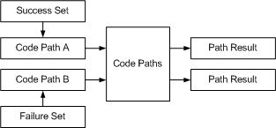
Parameter-Range Pattern
Code-Path pattern with more than a single parameter test

Slide 14
Data Driven Test Patterns
Patterns which enable testing units with a
broad range of input, output pairs
Simple-Test-Data Pattern
Data-Transformation-Test Pattern

Slide 15
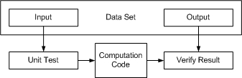
Simple-Test-Data Pattern
Reduces complexity of Parameter-Range unit by separating test data from the test.
Test data is generated and modified independent of the test
Results are supplied with the data set. Variances in the result are not permitted
Candidates for this pattern: Checksum Calculations, mathematical algorithims, etc…

Slide 16

Data-Transformation-Test Pattern
Works with data in which a qualitive measure of the result must be performed.
Typically applied to transformation algorithms such as lossy compression

Slide 17
Data Transaction Patterns
Patterns embracing issues of data persistence
and communication
Simple-Data-I/O Pattern
Constraint Data Pattern
The Rollback Pattern

Slide 18

Simple-Data-I/O Pattern
Verifies the read/write functions of the service

Slide 19
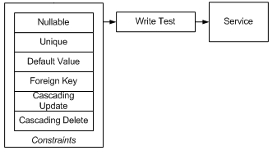
Constraint Data Pattern
Adds robustness to Simple-Data-I/O pattern by testing more aspects pf the service and any rules that the service may incorporate
Unit test verifies the service implementation itself, whether a DB schema, web service, etc…

Slide 20
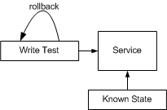
Rollback Pattern
Verifies rollback correctness
Most transactional unit tests should incorporate ability to rollback dataset to known state, in order to undo test side effects

Slide 21
Collection Management Patterns
Used to verify that the code is using the correct
collection
Collection-Order Pattern
Enumeration Pattern
Collection-Constraint Pattern
Collection-Indexing Pattern

Slide 22

Collection-Order Pattern
Verifies expected results when given an unordered list
The test validates that the result is as expected:
unordered, ordered or same sequence as input
Provides implementer with information on how the container manages the collections

Slide 23
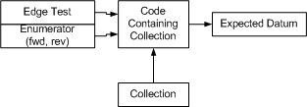
Enumeration Pattern
Verifies issues of enumeration or collection traversal
Important test when connections are non-linear. i.e. collection tree nodes
Edge conditions (past first or last item) are also important to test

Slide 24
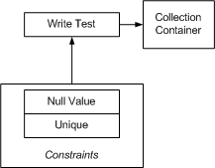
Collection-Constraint Pattern
Verifies that the container handles constraint violations: null values and duplicate keys
Typically applies to key-value pair collections

Slide 25
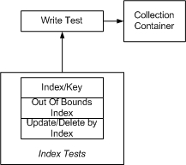
Collection-Indexing Pattern
Verifies and documents indexing methods that the collection must support – by index and/or by key
Verifies that update and delete transactions that utiilize indexing are working properly and are protected against missing indexes

Slide 26
Performance Patterns
Used to test non functional requirements as
performance and resource usage
Performance-Test Pattern

Slide 27

Performance-Test Pattern
Types of performance that can be measured:
Memory usage (physical, cache, virtual)
Resource (handle) utilization
Disk utilization (physical, cache)
Algorithm Performance (insertion, retrieval)

Slide 28
Simulation Patterns
Used to verify that the code is using the correct
collection
Mock-Object Pattern
Service-Simulation Pattern
Bit-Error-Simulation Pattern
Component-Simulation Pattern

Slide 29
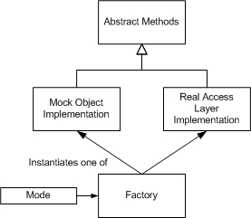
Mock-Object Pattern
Classes need to be abstracted, objects must be constructed in factories, facades and bridges need to be used to support abstraction
Alternatively, AOP practices can be used to establish a pointcut

Slide 30
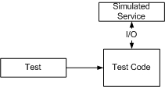
Service-Simulation Pattern
Test simulates connection and I/O method of a service
Useful when developing large applications in which functional pieces are yet to be implemented

Slide 31
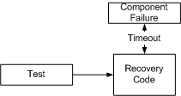
Component-Simulation Pattern
Mock object simulates a component failure, such as network cable, hub or other device
After a suitable time, the mock object can do a variety of things:
  Thrown an exception
  Returns incomplete of completely missing data
  Return a “timeout” error

Slide 32
Multithreading Patterns
In order to perform many threading tests
correctly, the unit tester must itself execute
tests as separate threads.
Signaled Pattern
Deadlock-Resolution Pattern

Slide 33

Signaled Pattern
This test verifies that a worker thread eventually signals the main thread or another thread

Slide 34

Deadlock-Resolution Pattern
Verifies that dead locks are resolved

Slide 35
Stress-Test Patterns
Verify unit’s performance under stress
Bulk-Data-Stress-Test Pattern
Resource-Stress-Test Pattern
Loading-Test Pattern

Slide 36
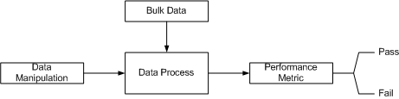
Bulk-Data-Stress-Test Pattern
Designed to validate performance of data manipulation when working with large data sets
Will reveal inefficencies in insertion, access
Typically corrected by reviewing indexing, constrains, reexamining if code should be client or server side

Slide 37

Resource-Stress-Test Pattern
Depends on the features of the operating system (may be served by using mock objects)
If not supported by OS, mock objects must be used to simulate the response of the operating system under a low resource condition

Slide 38

Loading-Test Pattern
Measures behavior of the code when another machine, application, or thread is loading the “system” (i.e. high CPU usage or network traffic)
Ideally, a unit test simulating high volume of network traffic would create a thread to inject packets onto the network

Slide 39
Presentation Layer Patterns
1. Verify that information is getting to the user
right at the presentation layer itself
2. The internal workings of the application are
correctly setting presentation layer state.
View-State Test Pattern
Model-State Test Pattern

Slide 40
Process Patterns
A process is just a different type of unit.
Validate state transitions and business rules
Process-Sequence Pattern
Process-State Pattern
Process-Rule Pattern

Slide 41
Pattern Summary
Unit Test patterns cover broad aspects of development; not just functional
May promote unit testing to become a more formal engineering discipline
Helps identify the kind of unit tests to write, and its usefulness.
Allows developer to choose how detailed the unit tests need to be

Slide 42
Some Best Practices
Naming standards for unit tests
Test coverage and testing angles
When should a unit test be removed or changed?
Tests should reflect required reality
What should assert messages say?
Avoid multiple asserts in a single unit test
Mock Objects Usage
Making tests withstand design and interface changes – remove code duplication

Slide 43
Naming standards for unit tests
Test name should express a specific requirement
Test name should include the expected input or state and the expected result output or state
Test name should include name of tested method or class
Example:
Given method: Public int Sum(params int[] values)
with requirement to ignore numbers > 1000 in the summing
Process
Then test name should be Sum_NumberIgnoredIfBiggerThan1000

Slide 44
Test coverage and testing angles
Q: How can one check if a unit test has good coverage over the tested code?
A: Try removing a line or a constraint check.
Example:
Public int Sum (int x,int y, bool allowNegatives)
{
if
{
if (x<0 || y<0) throw exception;
}
return x+y;
}
(!true)
(!allowNegatives)

Slide 45
When should a test be changed or removed?
Generally, a passing test should never be removed. They make sure that code changes don’t break working code.
A passing test should only be changed to make it more readable.
When failing tests don’t pass, it usually means there are conflicting requirements:
Example:
[ExpectedException(typeof(Exception),Negatives not allowed)]
Void Sum_Negative1stNumberThrowsException()
{
Sum (-1,1,2);
}
New features allows negative numbers.

Slide 46
When should a test be changed or removed?
New developer writes the following test:
Void Sum_Negative1stNumberCalculatesCorrectly()
{
Int sumResult = sum(-1,1,2);
Assert.AreEqual(2,sumResult);
}
Earlier test fails due to a requirement change – it’s no longer valid
Two course of actions:
Delete the failing test after verifying that it’s not valid
Change the old test:
  Either testing the new requirement
  Or to test the older requirement under new settings

Slide 47
Tests should reflect required reality
Example:
Int Sum(int a,int b) – returns sum of a & b
What’s wrong with the following test?
Public void Sum_AddsOneAndTwo()
{
int result = Sum(1,2);
Assert.AreEqual(4, result, “bad sum”);
}
Common mistake is to confuse the “Fail first” requirement with “Fail by testing something illogical”
A failing test should prove that there is something wrong with the production code and not the unit test code

Slide 48
What should assert messages say?
Assert message in a test is one of the most important things.
Tells us what we expected to happen but didn’t, and what happened instead
Good assert message helps us track bugs and understand unit tests more easily
DO:
  Express what should have happened and what did not happen
    “Foo should have thrown an exception”
    “Fodd didn not throw any exception”
    Foo should have returned a new ID”
    “Foo did not open the connection before returning it”
DON’T:
    Provide empty or meaningless messages
    Provide messages that repeat the name of the test case
    Provide messages that simply state the test inputs

Slide 49
Avoid multiple asserts in a single unit test
Consider the following test:
Void Sum_AnyParamBiggerThan1000IsNotSummed()
{
Assert.AreEqual(3, Sum(1001,1,2);
Assert.AreEqual(3, Sum(1,1001,2);
Assert.AreEqual(3, Sum(1,2,1001);
}
Disadvantages of multiple asserts in one test case:
If the first assert fails, the test execution stops for this test case.
Favor failure of multiple tests over a failure of one test with multiple asserts
Affect future coders to add assertions to test rather then introducing a new one

Slide 50
Mock Objects Usage
Q: When should mock objects be used?
A: Mock objects are used when one needs to replace or remove dependencies from code under test
For example
class LoginManager manages user logins with the following responsibility:
When login fails, class reports to a logger class or email class
The unit test should test the class logic without having to configure or rely on the availability of the logger class or email class
So we replace the logger class with a “fake” one which can also mimic various scenarios of failures which are hard to recreate in real life

Slide 51
Making tests withstand design and interface changes – remove code duplication
Re-design is a major pitfall developers writing unit tests might face.
A sudden design change – removal of a default constructor, new parameters added, etc… - might break many of the unit tests that have already been written.
All hell breaks loose and the developer starts fixing hundreds of tests.
Guidelines to prevent the scenario described above:
Encapsulate object creation code
Encapsulate complex or lengthy object initialization code
Apply these helper methods only when duplicate code across the tests is detected

Slide 52
Unit Testing Frameworks
JUnit - First Unit Testing Framework developed by Erich Gamma and Kent Beck
Since then Unit Testing Frameworks have been developed for a broad range of computer languages.
List of xUnit frameworks can be found at:
http://www.testingfaqs.org/t-unit.html
http://www.xprogramming.com/software.htm

Slide 53
NUnit - Features
Test code is annotated using custom Attributes
Test code contains Assertions
Supports Configuration Files
Tests organized as Multiple Assemblies

Slide 54
NUnit – Attribute Listing
  [TestFixture]
  [TestFixtureSetUp]
  [TestFixtureTearDown]
  [Test]
  [SetUp]
  [TearDown]
  [ExpectedException(typeof(Exception))]
  [Ignore(“message”)]

Slide 55
NUnit – Attributes
[TestFixture] - This attribute marks a class that contains tests, and, optionally, setup or teardown methods
[Test] - The Test attribute marks a specific method inside a class that has already been marked as a TestFixture, as a test method
[TestFixtureSetUp] - Used to indicate a setup method that will be ran once; before all other tests. This is the first method that is called before the tests are started
[TestFixtureTearDown] - Used to indicate a tear down method that will be ran once; after all other tests have run. This is the last method that is called after all the tests have finished.

Slide 56
NUnit – Attributes
[SetUp] - Used to indicate a setup method should be ran before each of the tests
[TearDown] - Used to indicate a tear down method should be ran after each of the tests are ran
[ExpectedException(typeof(Exception))] –
  When you want an exception to be thrown
  Will only pass if exception type was throw
[Ignore(“Not ready for primetime”)] - Used when a test is not ready, or you don’t want the test to be ran

Slide 57
NUnit - Example
Class:
namespace bank
{
public class Account
{
private float balance;
public void Deposit(float amount)
{
balance+=amount;
}
public void Withdraw(float amount)
{
balance-=amount;
}
public void TransferFunds(Account destination, float amount)
{
}
public float Balance
{
get{ return balance;}
}
}
}

Slide 58
NUnit - Example
Test:
namespace bank
{
using NUnit.Framework;
[TestFixture]
public class AccountTest
{
[Test]
public void TransferFunds()
{
Account source = new Account();
source.Deposit(200.00F);
Account destination = new Account();
destination.Deposit(150.00F);
source.TransferFunds(destination, 100.00F);
Assert.AreEqual(250.00F, destination.Balance);
Assert.AreEqual(100.00F, source.Balance);
}
}
}

Slide 59
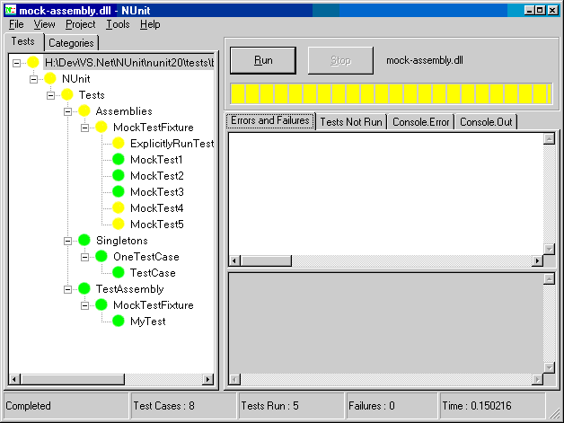
NUnit – Screen Shots

Slide 60
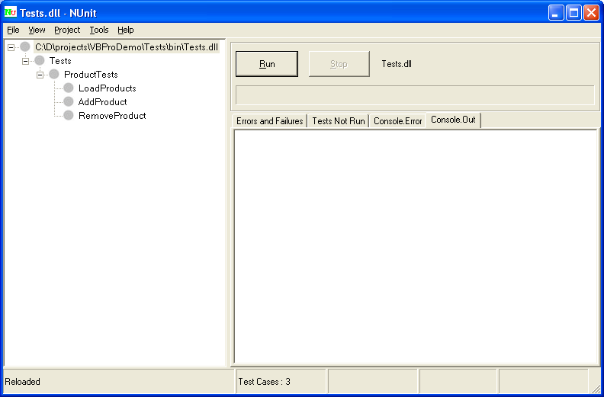
NUnit – Screen Shots

Slide 61
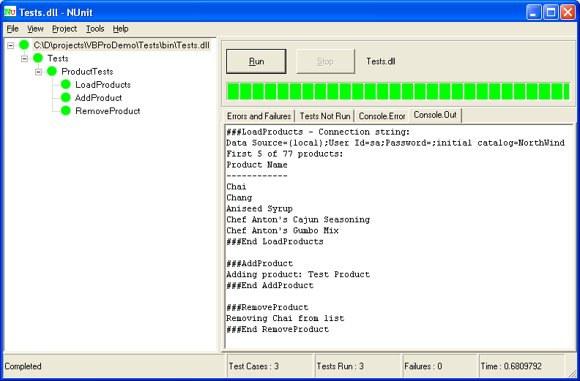
NUnit – Screen Shots

Slide 62
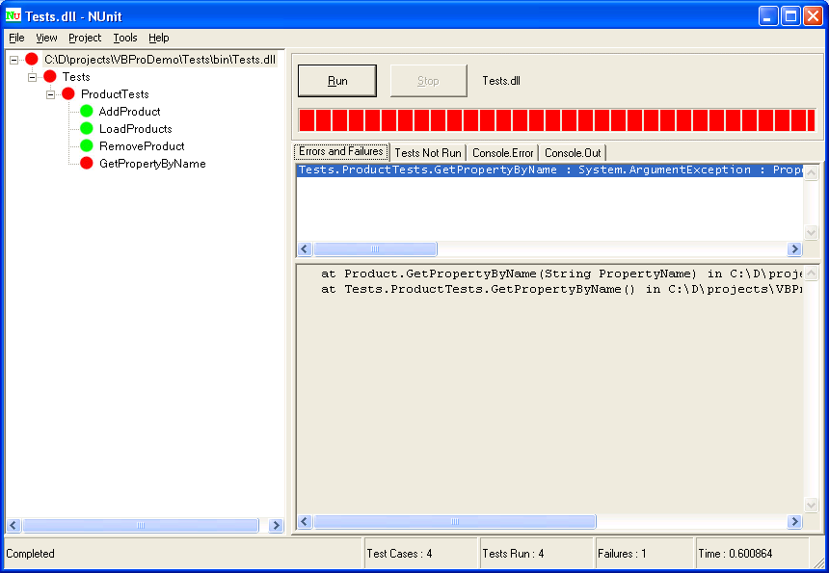
NUnit – Screen Shots

Slide 63
Summary
The concept of Unit Testing has been around for many years
New methodologies in particular XP, have turned unit testing into a cardinal foundation of software development.
Writing good & effective Unit Tests is hard!
This is where supporting integrated tools and suggested guidelines enter the picture.
The ultimate goal is tools that generate unit tests automatically

Slide 64
Refrences
http://www.extremeprogramming.org/
Advanced Unit Test, Part V - Unit Test Patterns by Mark Clifton -http://www.codeproject.com/gen/design/autp5.asp#Introduction0
Best Practices -http://weblogs.asp.net/rosherove/category/9834.aspx?Show=All
www.junit.org

